Slide 1
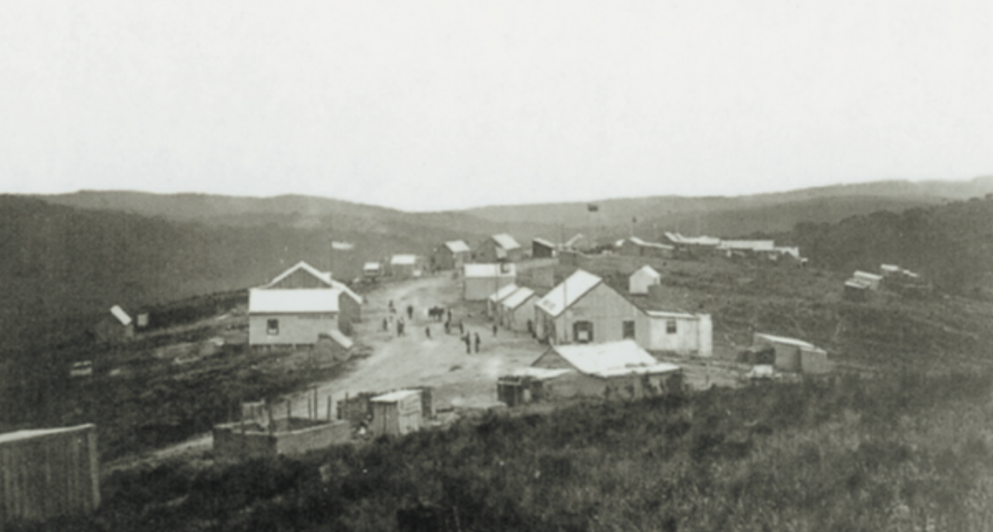
Millwood Times (Pty) Ltd
9 Wassung Street, Mossel bay, 6500
Past, Present & Future
Reflect, Live & Imagine

